Slide 1

TOPIC:
MY FAVORITE HOTEL:
ACE BEN THANH HOTEL
Student name
: Ngô Văn Cảm (PD02105)
Class
: PT13307
Subject
: ENT2123
Teacher
: Ms.Trương Thị Hoàng Phúc

Slide 2
H
History and location
R
Room types
S
Services

Slide 3
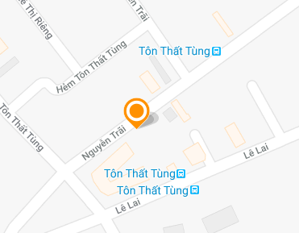
History and location
For a comfortable moment after a day of tired sightseeing, everyone wants to have the ideal to get away. I chose Ace Ben Thanh Hotel as an ideal hotel for me. It is located in the centre of Ho Chi Minh City, near the Ben Thanh Market.

Slide 4
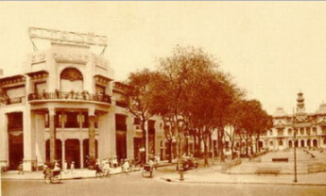
History and location
- in 1990, when ACE Ben Thanh Hotel was opened in Ho Chi Minh city
- When it was first established, it was called Ben Thanh Hotel
- In 2011 it was renamed, as Ace Ben Thanh Hotel
- ACE Ben Thanh is the perfect choice for you in Ho Chi Minh City.

Slide 5
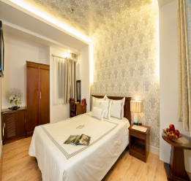
Room types
- The first type of room, SUPERIOR DOUBLE with the price of 20 USD has a room size of 18 m².

Slide 6
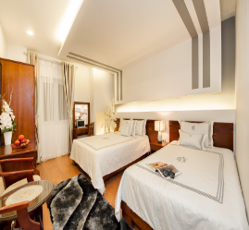
Room types
- The second type of room is the FAMILY ROOM WITH WINDOW with price of 50 USD, and a room size of 32 m².

Slide 7
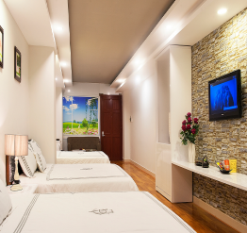
Room types
- The last type of room is the VIP ROOM with a price of 100 USD and a room size of 45 m².

Slide 8
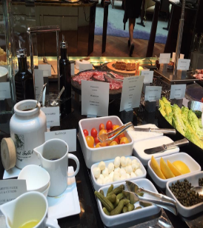
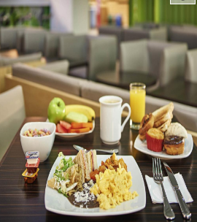
Services
- in the hotel you can enjoy like free Wi-Fi in all rooms, 24-hour security, daily housekeeping, photocopying, postal service.
- Come to ACE BEN THANH Hotel. It will bring you the exciting moments of relaxation, the traditional dishes of Viet Nam. With space, extra width, classic, ACE BEN THANH hotel is bring having fun, eating, drinking coffee, listening to music, and reading books.

Slide 9

With modern architectural design will give you a feeling of comfort when coming to the hotel. Come to ACE BEN THANH Hotel to feel attentive service with modern space, luxurious with no less interest with the food served by the hotel.

Slide 10
Thank You For Your
Listening

